Slide 1
How to Change the World
A guide to social action for pupils in Cardiff
Your voice is powerful! When you share your ideas and speak to the right people, you can make big changes in your community, across the country and even the world. This guide is here to help you do just that—turn your thoughts into actions that reach the right people and make a difference.
Notes:
There are over 50,000 children in Cardiff, you all have rights and you are all important. In Wales, all the adults in your school, the council, and the government have a responsibility make sure your rights are met. Your thoughts, ideas, and voices matter. This guide was made to help you use your voice to make your community, country, and the
world a better place. By sharing your ideas and speaking to the right people, you can make big changes locally and globally.

Slide 2
What is social action?
Social action is when you do something to help make your school, community, or the world a better place. It means taking action to solve a problem or improve something that you care about.
You might have already done some social action projects, like:
Organising a litter pick to keep your playground clean.
Setting up a uniform swap shop.
Planting trees or flowers to help the environment.
Starting a recycling program at school.
Social action is all about working together
to make a difference and help others!
Notes:
Define social action: "Social action is when we do things to improve our lives and the lives of others. It can be anything from a small local project to a big movement that affects many people.“
Engage the class with examples and ask them to share any they know: "Can anyone think of an example of social action, maybe something we’ve done in school or something you’ve seen in our community or heard about in the news?“
Highlight the importance of their involvement: Young people around the world have the right to speak out and be heard on matters that affect them. This idea is captured in law in the UN Convention on the Rights of the Child: UNCRC Article 12: Every child has the right to say what they think in all matters affecting them, and to have their views taken seriously.

Slide 3
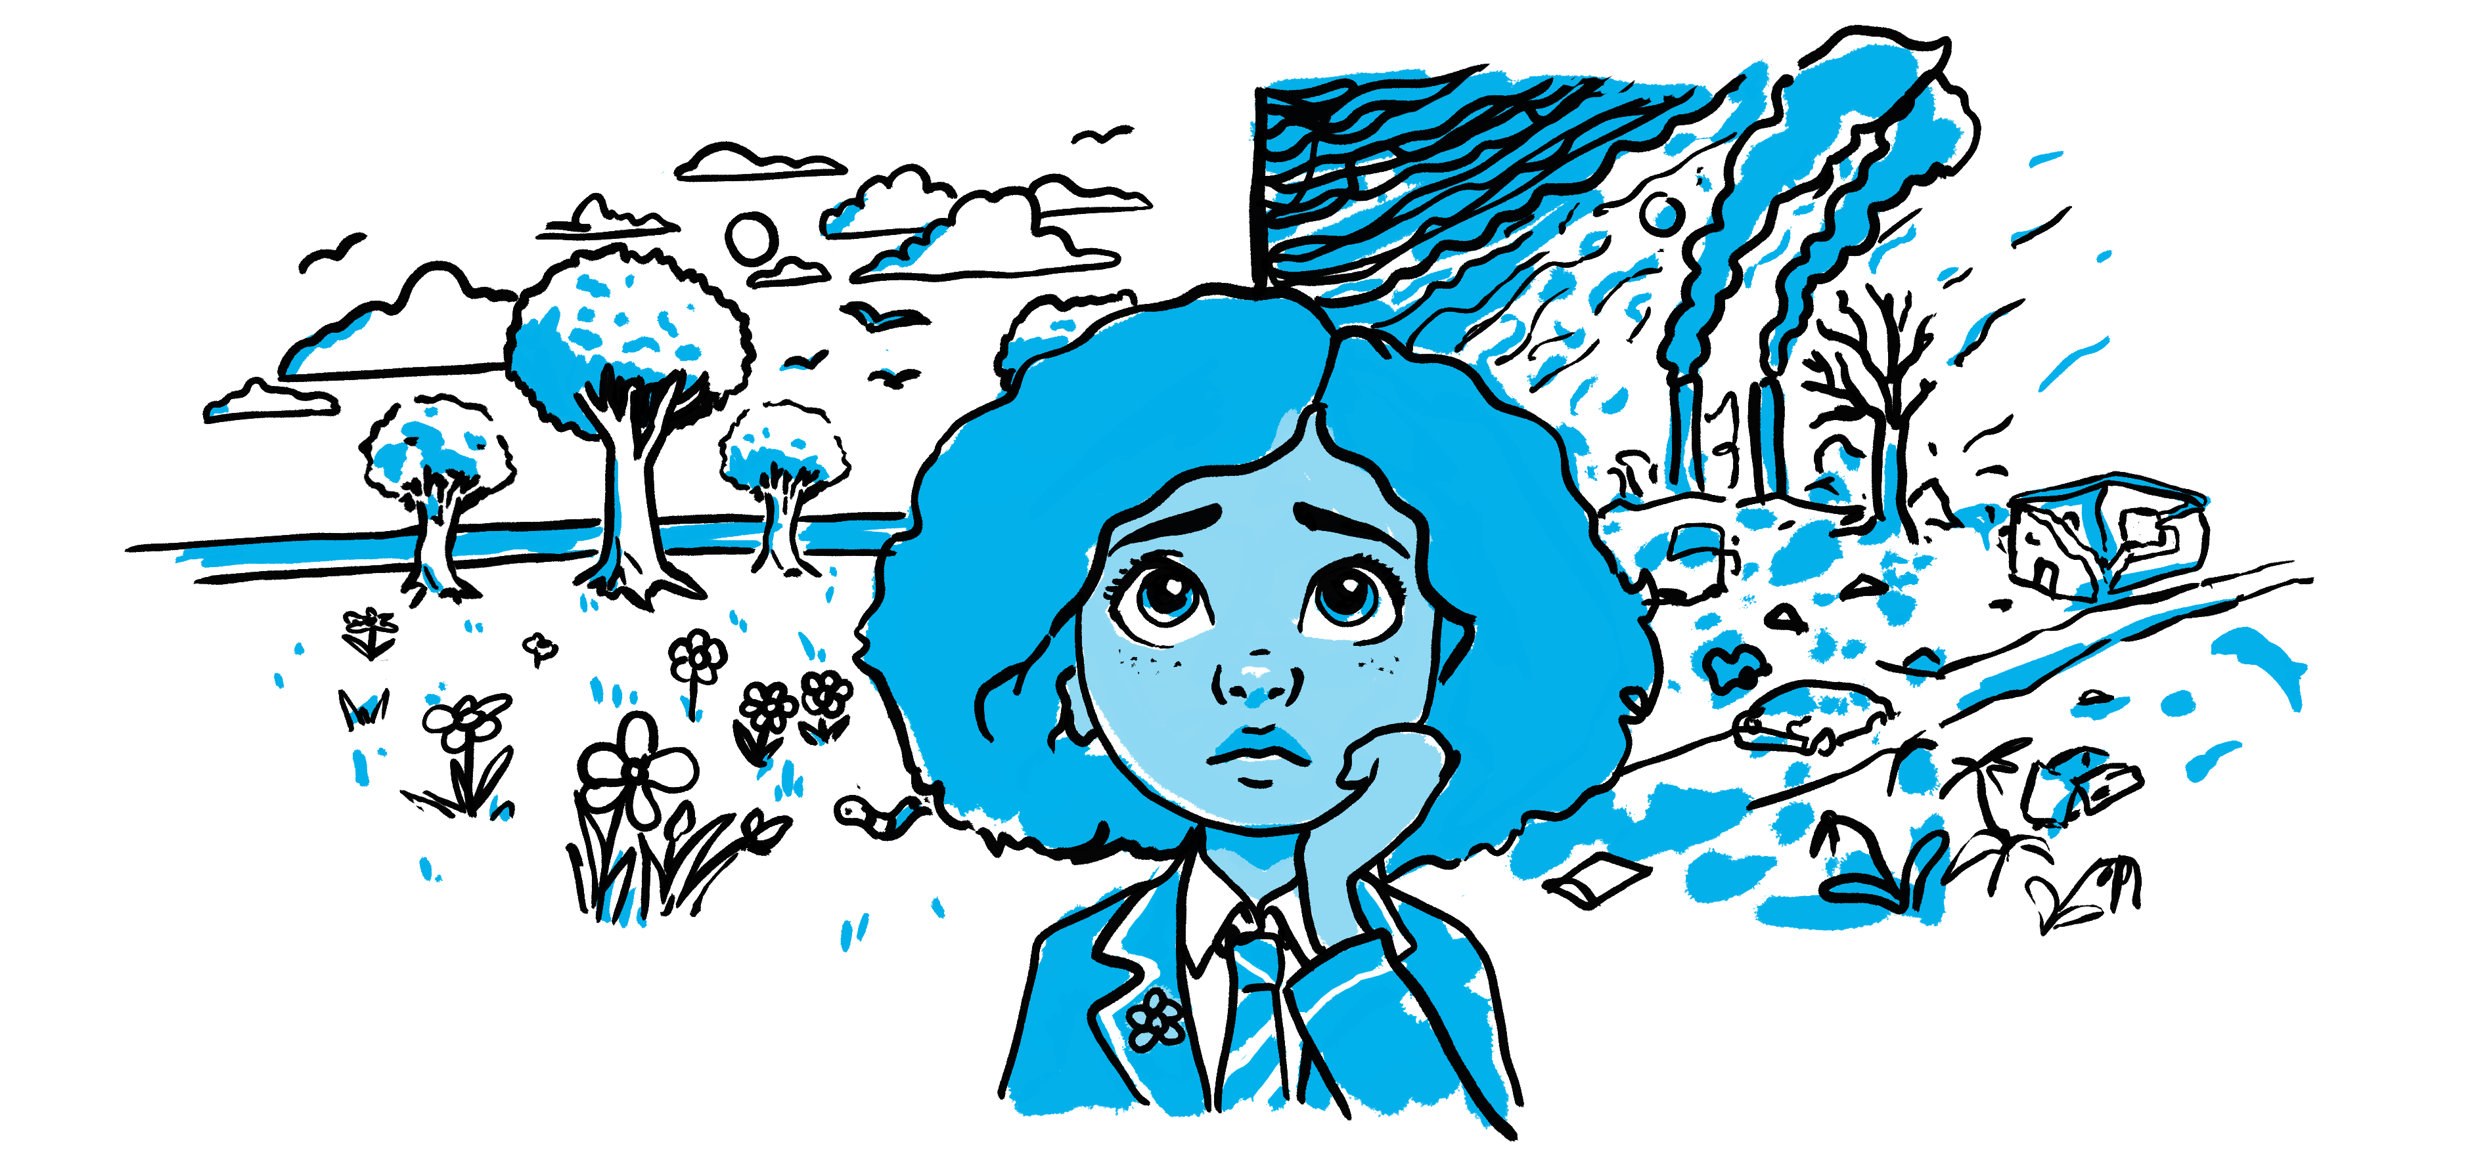
What’s the problem you want to fix?
What do you care about?
How might this issue affect children in your school, Cardiff or around the world?
Gwenno is growing up in a world that’s getting hotter and hotter, everywhere she looks is pollution and rubbish. The adults in her life mean well but she can’t see change!
Notes:
Activity: Ask students to think of examples of social action they have helped with, seen or heard about in their community.
Questions: "Can anyone think of any social action projects we’ve done as a school? Or something you or your family has taken part in or seen in the community? What was its impact?"

Slide 4
Imagine a better world…
How could things be better?
In an ideal world, this problem might not exist... why?
Sometimes problems can be simple, sometimes more difficult.
Gwenno wants to see a cleaner community, with less rubbish, less cars, and less waste. She wants to look after nature and for adults to care about the future they are passing on.
Notes:
Activity: Ask students to think of examples of social action they have helped with, seen or heard about in their community.
Questions: "Can anyone think of any social action projects we’ve done as a school? Or something you or your family has taken part in or seen in the community? What was its impact?"

Slide 5
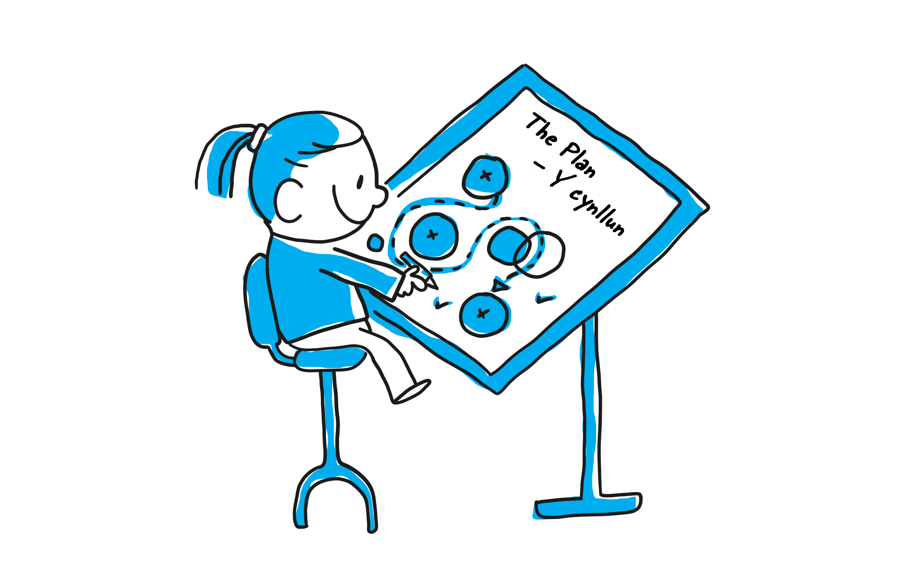
What’s the plan?
Now that you have your story and some ideas on how to make a change, it’s time to bring those ideas to life!
Remember, these are just examples you can choose any topic and actions you like. Each action has its own impact, and together, they can create a big difference.

Slide 6
Write a Letter to local councillor asking for more bike storage
Promotes active travel and reduces carbon footprint

Slide 7
Plan a climate change themed school fair
Promotes active travel and reduces carbon footprint

Slide 8
Write and perform a play about climate change
Educate and inspire action through creativity

Slide 9
Make a sculpture from empty plastic bottles
More creative way to share our message that we’re worried about litter.

Slide 10
Start a Senedd Petition to ban single use plastic
Reducing plastic waste for future generations

Slide 11
^{Start a Tree Planting Project}
Start local then try to get the government involved

Slide 12
^{School energy saving programme}
Reduces energy use, saves the school money and teaches good habits

Slide 13
Peaceful Protest for Climate Action
Draws public and media attention to climate issues, maybe we could ask other schools to join us

Slide 14
Leaflet Campaign in Local Shops
Partner with businesses to spread awareness on how to look after our environment

Slide 15
^{Ask for Vegan School Lunches}
They reduce environmental impact of our school meals

Slide 16
Organise a litter pick with parents
Direct action to clean up local areas, raises environmental awareness

Slide 17
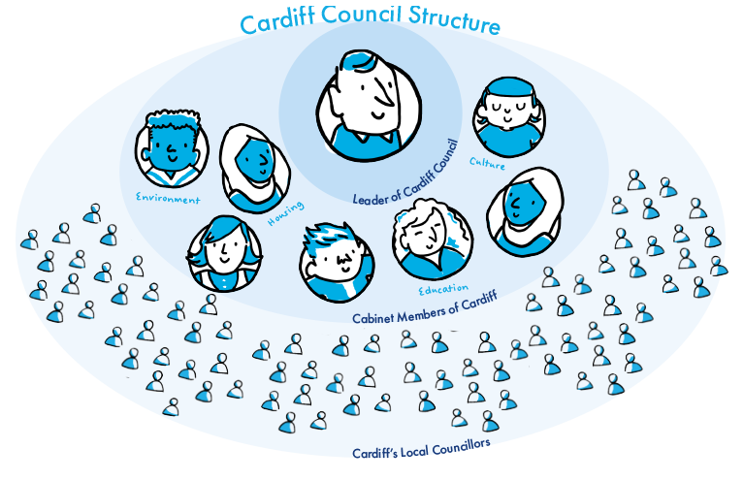
Meet local Decision makers and take action!
Cardiff Council a big team of thousands of people that takes care of our city, Cardiff. Just like your school has teachers and staff who help make sure everything runs smoothly; Cardiff Council does that for our whole city. They cover lots of areas, including, culture, education, housing, transport, helping families, and the environment.
The council is run by thousands of employees but led by “councillors” these councillors are normal people elected by the public. They choose the direction and make the important decisions.
Notes:
If your problem is about things going on in Cardiff, then contacting a councillor is a good idea! But which ones...
The Leader and Cabinet Members: The Leader of the council is elected by all councillors. The leader then chooses a group of other councillors to look after important things like climate change, education and transport - they are ‘the cabinet’. They help shape the councils plans and aims that affect the whole city.

Slide 18
The Leader and Cabinet Members:
The Leader and
Cabinet Members:
The Leader of the council is elected by all councillors. The leader then chooses a group of other councillors to look after important things like climate change, education and transport - they are ‘the cabinet’. They help shape the councils plans and aims that affect the whole city.
Find out who they are here!
If your problem is about something that affects all children in Cardiff then writing to the right cabinet member might help bring about change!

Slide 19
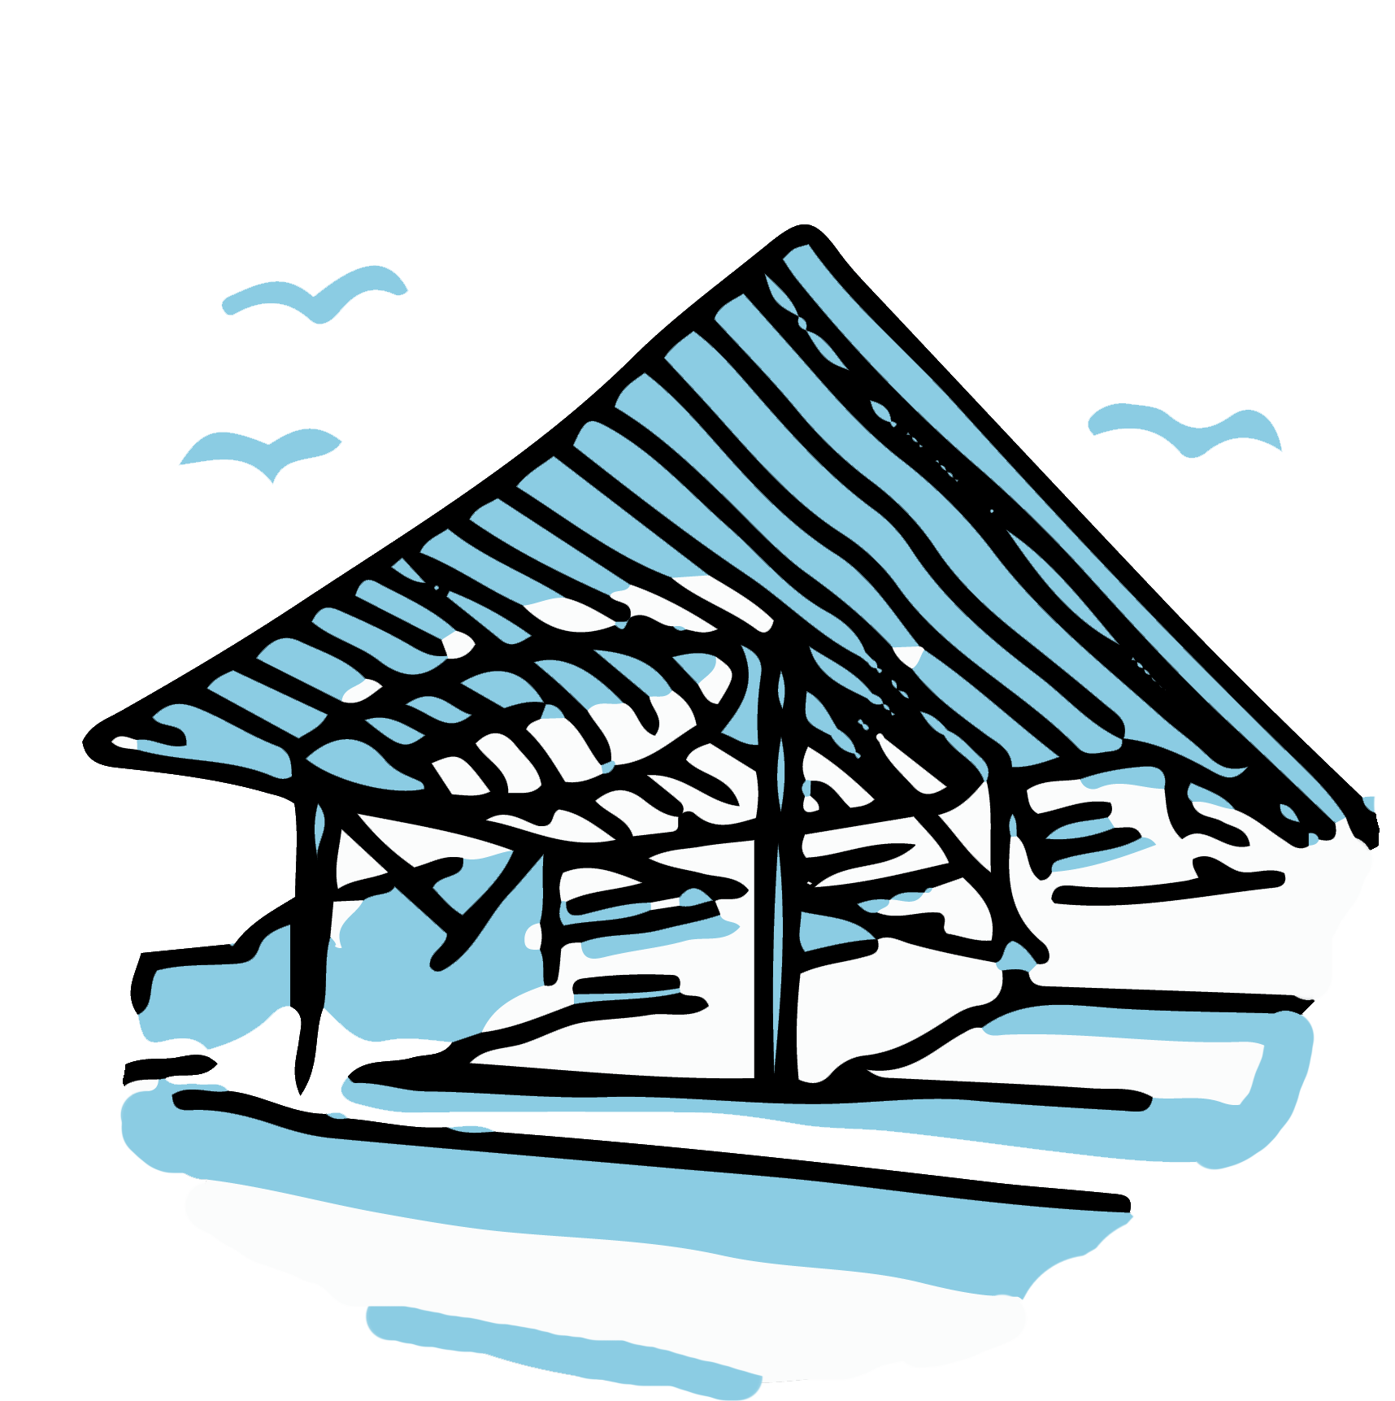
Local Councillors
Cardiff’s Local Councillors: These are the people who help look after our local areas. They have been chosen by local residents during local elections and are the first person to contact with local problems and concerns. In Wales, councillors vote on important council plans - the council is led by them. Find out who your local councillors are, write to them and invite them to your school!
If the problem is smaller and mainly affects people in your area writing to your local councillor might be a good place to start!

Slide 20
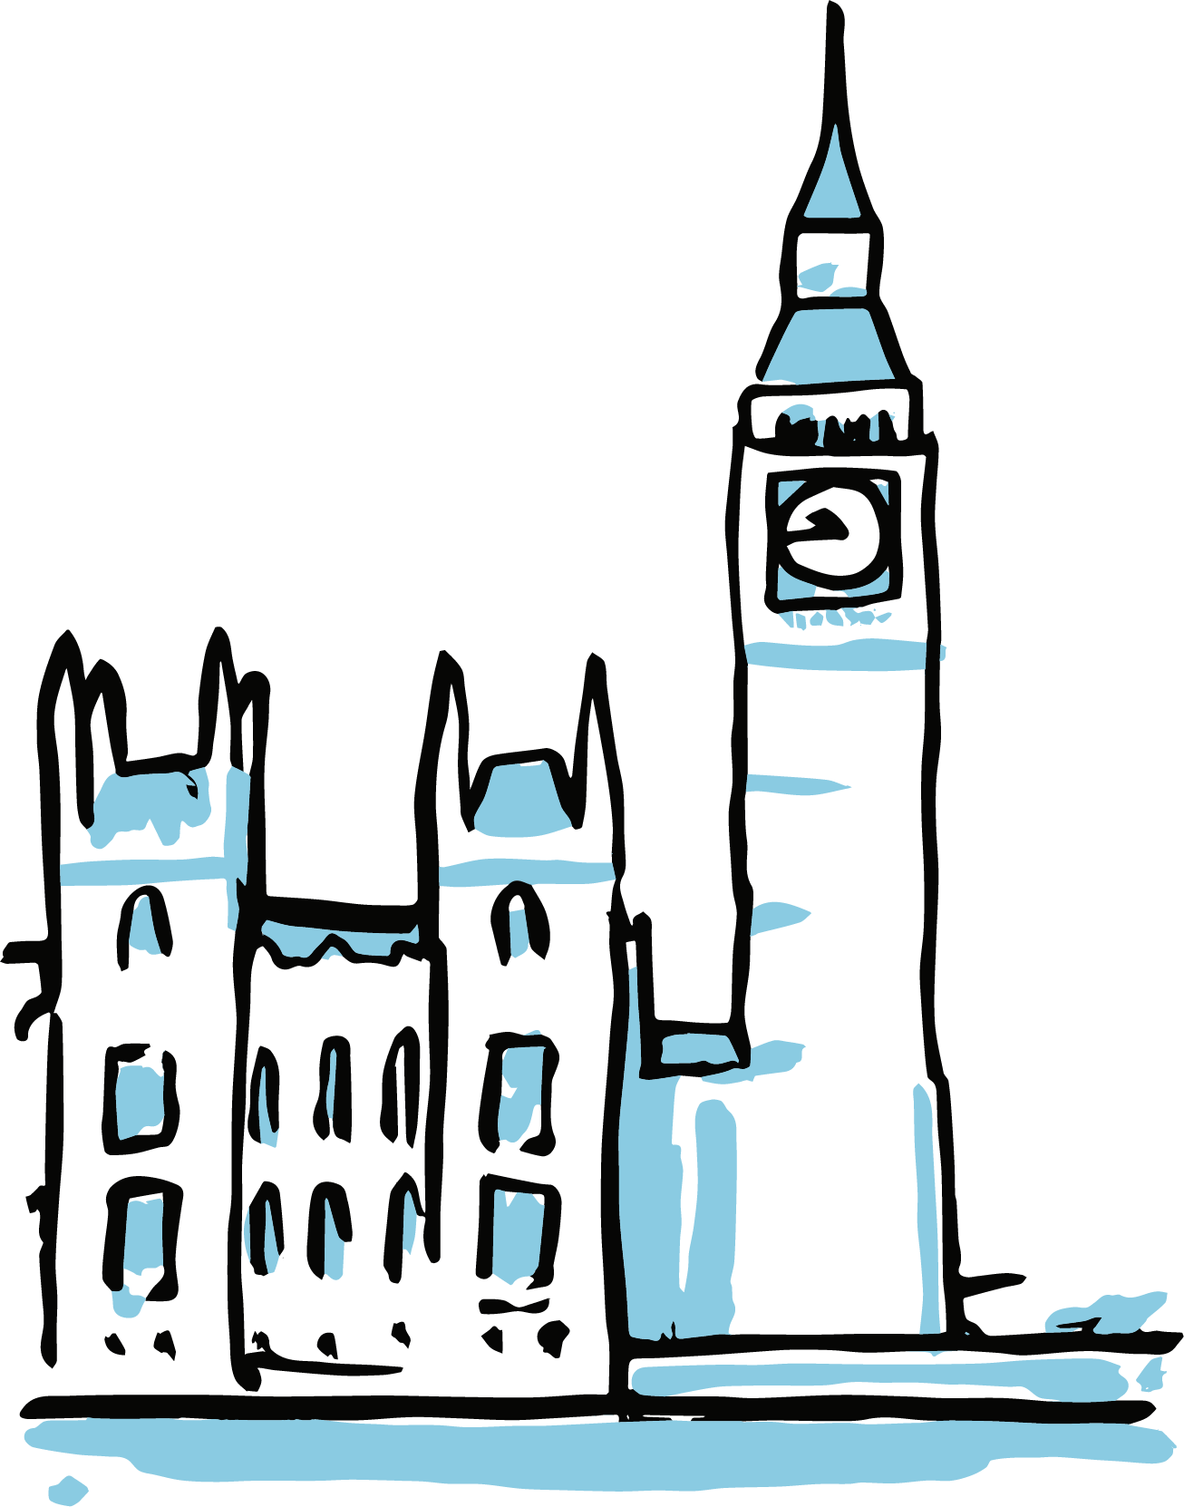
Members of the Senedd
What is the Senedd?
The Senedd is the Welsh Parliament. It is made of a group of people called Members of the Senedd, or MSs, who are elected to make decisions and create laws for Wales. The Senedd takes care of important things that affect all of Wales, such as schools, healthcare, and the environment. They make laws in Wales that can change how things are done in your community and across the country.
If your problem affects children across all of Wales, like rules about schools or health services, a Member of the Senedd (MS) can help. They work on big decisions that affect everyone in Wales, not just Cardiff.

Slide 21
Members of the UK Parliament
What is the UK Parliament?
The UK Parliament is the place where decisions are made for the whole of the United Kingdom, which includes Wales, England, Scotland, and Northern Ireland. It’s made up of elected people called Members of Parliament (MPs), who help create laws and decide how to spend money on important things like health, defence, and the environment.
If your problem is about something that affects all parts of the UK, such as laws about pollution, transport, and safety. Find out who your local MP is and get in touch!

